Slide 1
Object-Oriented Programming
Week 1 | Lecture 2

Slide 2
What is an Object?
An Object is:
Anything for which we want to save information
Something tangible (e.g. Cat, Car)
Something that can be captured intellectually
An Object has:
State/Attribute/Properties/Data
Well-defined Behavior/Methods/Functions

Slide 3
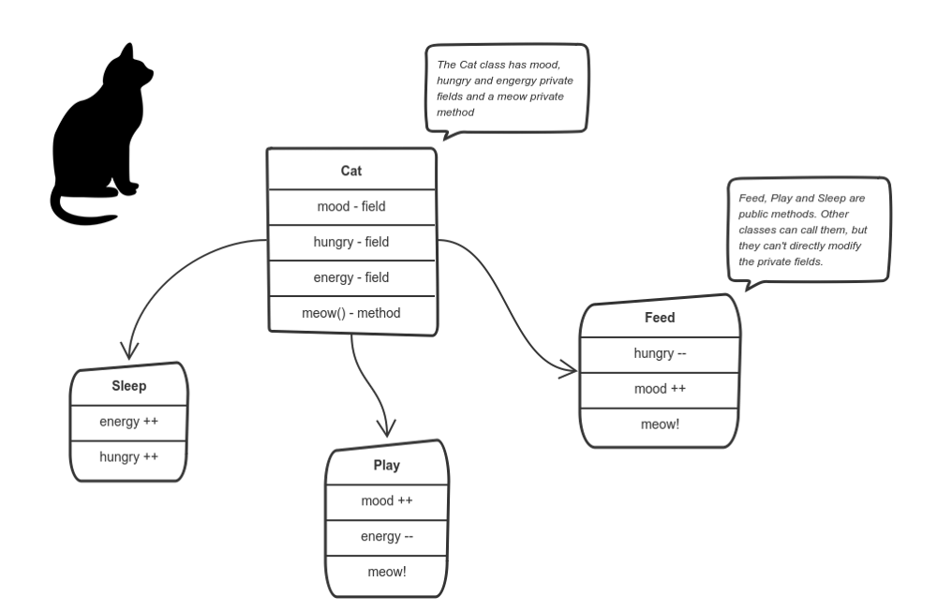

Slide 4

Exercise
Are there any ‘objects’ in this classroom?

Slide 5
Exercise
Are there any ‘objects’ in this classroom
Chair
Multimedia
Student
Teacher

Slide 6
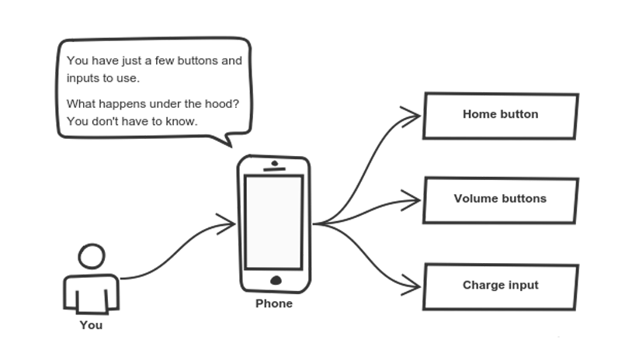

Slide 7
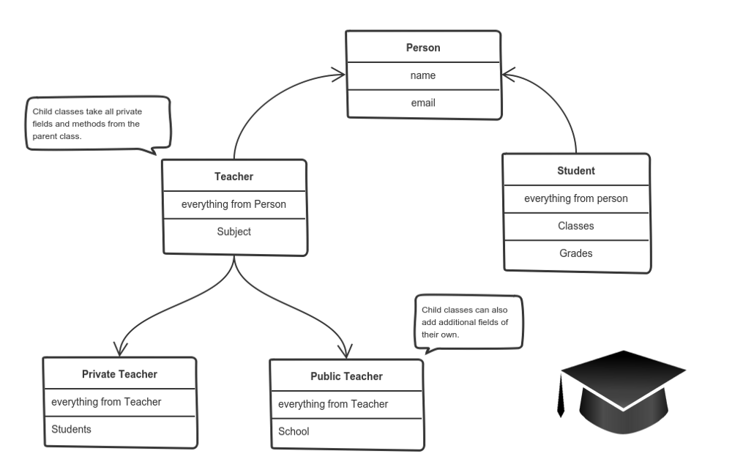

Slide 8

Exercise
Possible Objects in this university?

